Slide 1
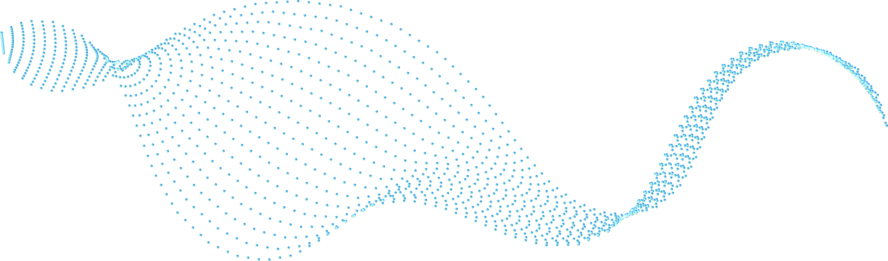
AI-BOT
(AID IN WRITING AND UNDERSTANDING COMPOSITIONS)
This article presents a solution for visually impaired students who face difficulties in studying text and electronic documents. An experimental prototype is developed using NLP techniques to assist the blind community with information access. The chatbot employs techniques such as automatic index generation, paraphrasing, summarizing, passage retrieval, and query rewriting. The chatbot uses tools such as Torch, Sentence piece, Newspaper3k, and the Natural Language Toolkit to achieve its goals.
The proposed software aims to reduce the time required for writing and understanding compositions, making information access easier for visually impaired students and other people.
Team Members :
Dhyan
Jeevantika Gurung
Shreyas MB

Slide 2
Abstract
This article presents a solution for visually impaired students who face difficulties in studying text and electronic documents. An experimental prototype is developed using NLP techniques to assist the blind community with information access. The chatbot employs techniques such as automatic index generation, paraphrasing, summarizing, passage retrieval, and query rewriting. The chatbot uses tools such as Torch, Sentence piece, Newspaper3k, and the Natural Language Toolkit to achieve its goals.
The proposed software aims to reduce the time required for writing and understanding compositions, making information access easier for visually impaired students and other people.
Automatically generate useful information on any topic with a few clicks and words.
Developed to make life easier for the blind community.
Powered by advanced NLP techniques and WordNet-based query rewriting, so you get relevant results in no time.
Get access to the right info with ease, as it is read aloud to you. No need for complicated navigation anymore.

Slide 3
Need of proposed Work
This article presents a solution for visually impaired students who face difficulties in studying text and electronic documents. An experimental prototype is developed using NLP techniques to assist the blind community with information access. The chatbot employs techniques such as automatic index generation, paraphrasing, summarizing, passage retrieval, and query rewriting. The chatbot uses tools such as Torch, Sentence piece, Newspaper3k, and the Natural Language Toolkit to achieve its goals.
The proposed software aims to reduce the time required for writing and understanding compositions, making information access easier for visually impaired students and other people.
Automatically generate useful information on any topic with a few clicks and words.
Developed to make life easier for the blind community.
Powered by advanced NLP techniques and WordNet-based query rewriting, so you get relevant results in no time.
Get access to the right info with ease, as it is read aloud to you. No need for complicated navigation anymore.

Slide 4
Proposed Architecture
INPUT
PROCESSING
OUTPUT
Speech to text
Automatic index generation.
Paraphrasing summarizer.
Passage retrieval.
Query retrieval.
Voice Enabled to read out the generated output

Slide 5
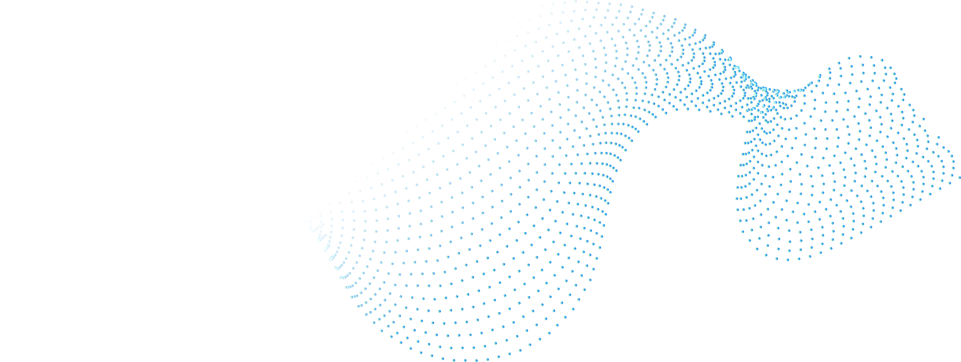

System requirements
Processor: Intel i3 9th gen(Min)
Ram: 4GB DDR4
Internet Connectivity
OS: Windows 7+
Language : Python
Libraries used : nltk, wordnet, pyTorch, openai, pyttsx3, speech_recognition, flask

Slide 6
Related Work
The existing tools provide text annotation tools, such as bookmarking, note taking, or outlining facilities. However, these facilities are often crude. For example, the user often cannot directly go to the position of a bookmark in the original document (through a hyperlink, for example), or integrate bookmarks into existing outlines; thus limiting his access.
NLP techniques used to improve the reading and writing tasks of the visually handicapped include word prediction and homonym checking. Word prediction allows the application to predict the most likely word to be typed given the previous context. The user types a letter and the program offers a list of the most likely words beginning with that letter. If the required word is on the list, it can be quickly selected. If the word is not on the list, typing the next letter will bring up a different choice and so on. Homonym support provides auditory and visual reinforcement of commonly confused like-sounding words. To avoid the confusion between homophones, the program colour codes confusable words and lists possible alternatives with audible definitions and sample sentences.

Slide 7
TIMELINE
Review 0
Review 2
Review 1
Review 3
Basic outline & framework
Fully-functional Protoype
The big Idea
Implementation and Integration

Slide 8
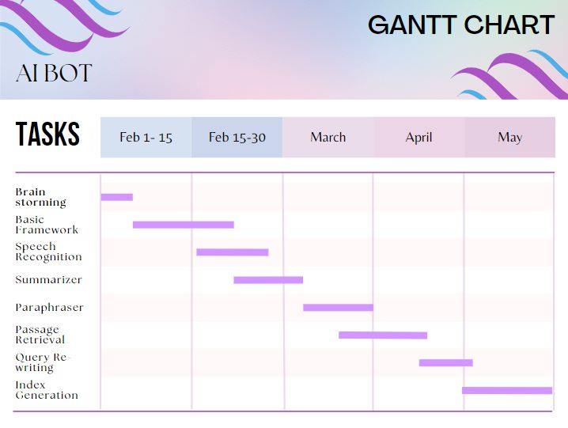
Gantt Chart

Slide 9
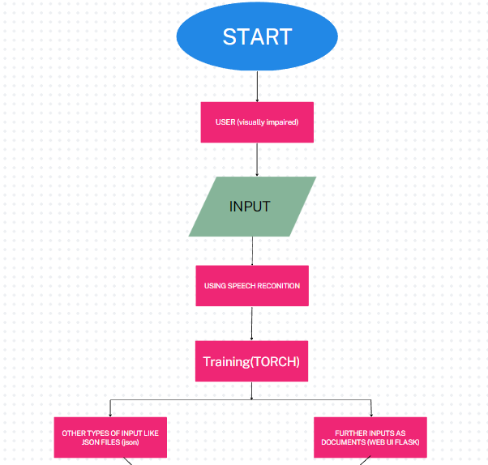
Flowchart

Slide 10
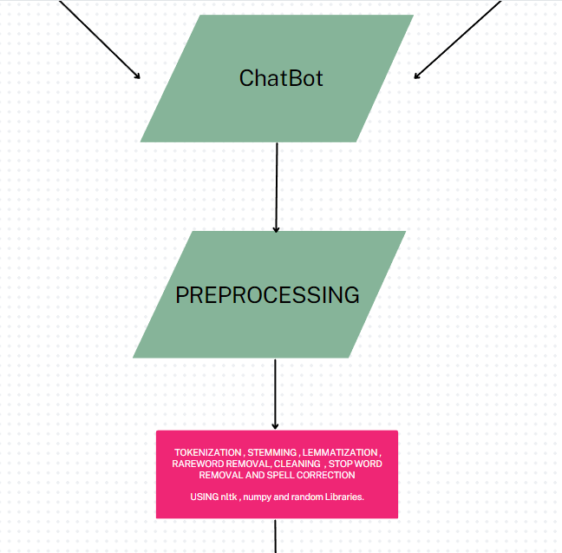

Slide 11
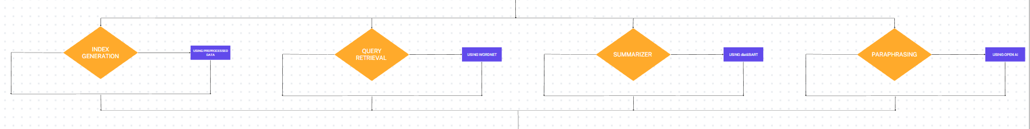

Slide 12
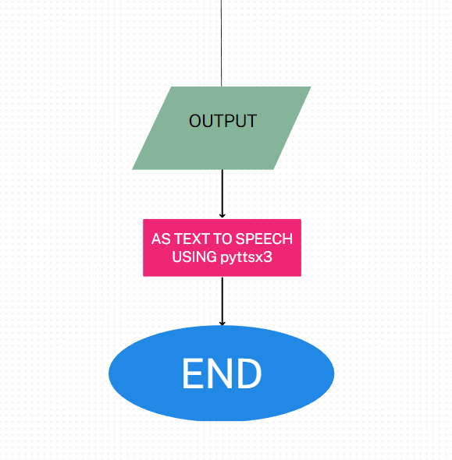

Slide 13
Module details
Flask - (Web User Interface)
Web application framework for Python that allows developers to easily build web applications.
Provides the backend functionality for web applications.
Flask UI is a term used to refer to the front-end user interface that is built on top of Flask.

Slide 14
Module details
Torch - (Training)
Python library for scientific computing and machine learning, particularly for building and training deep neural networks.
Based on the Lua(programming language) Torch library , includes :
Tensors(multi-dimensional array which supports GPU acceleration)
Optimizers(SGD, Adam etc)
Dataset Utilities

Slide 15
Module details
WordNet
structured database of English words, which are organized into sets of synonyms or "synsets“.
Each synset represents a distinct concept or meaning, and contains a list of words or phrases that are considered to be synonymous in that context.
Synsets are linked together by various semantic relations, such as antonymy, hypernymy, and hyponymy, to form a network of related concepts

Slide 16

Module details
NLTK - (Language Processing)
Tokenization
Stemming
Parsing
Tagging

Slide 17
Algorithms Utilized
Text Summarizer – DistilBART (Bidirectional and Auto-Regressive Transformers) [CNN-12-6]
Pre-trained transformer-based language generation model.
CNN-12-6 (Convolutional Neural Network)
12: Number of encoder layers in the transformer model.
Each encoder layer takes in a sequence of input tokens and applies a series of transformations to them.
6: Number of attention heads used in each encoder layer.
Captures multiple parts of the input sequence at the same time

Slide 18
Algorithms Utilized
Paraphrasing – text_davinci-002 (Generative Pre-trained Transformer 3)
Contains 175 billion parameters
Significantly larger than the previous largest GPT-3 variant, which has 13 billion parameters.
Trained using a massive amount of text data from the internet, including books, articles, and websites.
It is designed to be a general-purpose language model, meaning that it can handle a wide variety of natural language tasks without the need for task-specific training.

Slide 19
Algorithms Utilized
Inverted indexing
Tokenization
Stop-word removal
Stemming
Maps each word to the paragraphs in which it appears.
Checks only the paragraphs that contain the word or phrase of interest.

Slide 20
Algorithms Utilized
Query Retrieval – BERT(Bidirectional Encoder Representations from Transformers)
Masked language modelling
Masked Language Modelling is a task in natural language processing (NLP) that involves training a model to predict a missing word in a sentence.
Next sentence prediction.
Fine-tuned on the Stanford Question Answering Dataset (SQuAD), which is a popular dataset for evaluating question-answering systems.
Better efficiency and faster inference times while maintaining high accuracy.

Slide 21
Algorithms Utilized
Chatbot(Requests & Responses) – Feed Forward Neural Network
Linear Regression – ReLU
Optimization – Adaptive moment estimation (adam)
Loss calculation – CrossEntropy
Output - SoftMax

Slide 22

Models & Dataset
DistilBERT:
For Query Response, we are using the DistilBERT model pretrained on the same data as BERT, which is BookCorpus, a dataset consisting of 11,038 unpublished books and English Wikipedia (excluding lists, tables and headers).
BART:
For text summarization, the CNN / DailyMail Dataset is an English-language dataset containing just over 300k unique news articles as written by journalists at CNN and the Daily Mail.
Along with this, the Extreme Summarization(XSUM) dataset is used which also contains news articles and a one sentence summary of the same.
Custom Dataset:
For Chatbot Interaction, a custom dataset containing a set of responses and intents is also made in the format of a json folder which will be used to train the model used for text classification.

Slide 23
Pre-processing – Chatbot Interaction
Word Tokenization – The sentence received by the chatbot is split into multiple words
Stemming – Porter Stemmer is used for the initial preprocessing of text
Bag_of_words – Creates an Indexed array of for each known word in the sentence provided by the user which is passed on to the model for giving an appropriate response

Slide 24
Pre-Processing – Inverted Index generation
Sentence Tokenization - The paragraph received by the chatbot is split into multiple sentences
Stop word removal - Removing the words that occur commonly across all the documents in the corpus
Word Tokenization - The sentence received by the chatbot is split into multiple words

Slide 25
Pre-Processing – Query Response
Auto Tokenization –
A generic tokenizer class that will be instantiated as one of the tokenizer classes of the library when created with the AutoTokenizer from_pretrained() class method.
Used for utilizing the distilbert-base-uncased-distilled-squad model.

Slide 26
Inverted indexing (Input) :
Before you can begin to determine what the composition of a particular paragraph will be, you must first decide on an argument and a working thesis statement for your paper. What is the most important idea that you are trying to convey to your reader? The information in each paragraph must be related to that idea. In other words, your paragraphs should remind your reader that there is a recurrent relationship between your thesis and the information in each paragraph. A working thesis functions like a seed from which your paper, and your ideas, will grow. The whole process is an organic one—a natural progression from a seed to a full-blown paper where there are direct, familial relationships between all of the ideas in the paper.
The decision about what to put into your paragraphs begins with the germination of a seed of ideas; this “germination process” is better known as brainstorming. There are many techniques for brainstorming; whichever one you choose, this stage of paragraph development cannot be skipped. Building paragraphs can be like building a skyscraper: there must be a well-planned foundation that supports what you are building. Any cracks, inconsistencies, or other corruptions of the foundation can cause your whole paper to crumble.
So, let’s suppose that you have done some brainstorming to develop your thesis. What else should you keep in mind as you begin to create paragraphs? Every paragraph in a paper should be:
Unified: All of the sentences in a single paragraph should be related to a single controlling idea (often expressed in the topic sentence of the paragraph).
Clearly related to the thesis: The sentences should all refer to the central idea, or thesis, of the paper (Rosen and Behrens 119).
Coherent: The sentences should be arranged in a logical manner and should follow a definite plan for development (Rosen and Behrens 119).
Well-developed: Every idea discussed in the paragraph should be adequately explained and supported through evidence and details that work together to explain the paragraph’s controlling idea (Rosen and Behrens 119).

Slide 27
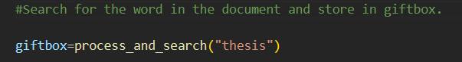
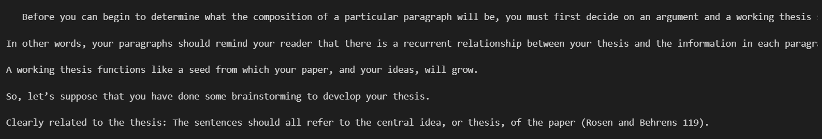
Inverted indexing (Output) :

Slide 28
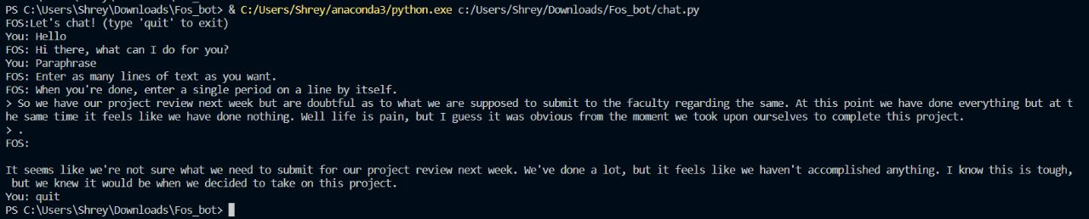
Paraphraser :

Slide 29
BART Summarizer:
text = """The Amazon rainforest is one of the world's most important ecosystems, providing a home for countless species of plants and animals.
It is also known for its rich soil, which has been formed over many centuries by the accumulation of nutrients from decaying vegetation. In addition to its ecological importance, the Amazon rainforest also plays a critical role in regulating the Earth's climate, serving as a major carbon sink and helping to maintain the balance of atmospheric gases. However, large areas of the rainforest are being destroyed due to human activities such as deforestation, agriculture, and industrialization, which threaten the long-term survival of the ecosystem and the species that depend on it."""

Slide 30
BART Summarizer:
OUTPUT: The Amazon rainforest is one of the world's most important ecosystems, providing a home for countless species of plants and animals . It is also known for its rich soil, which has been formed over many centuries by the accumulation of nutrients from decaying vegetation . Large areas of the rainforest are being destroyed due to deforestation and agriculture .

Slide 31
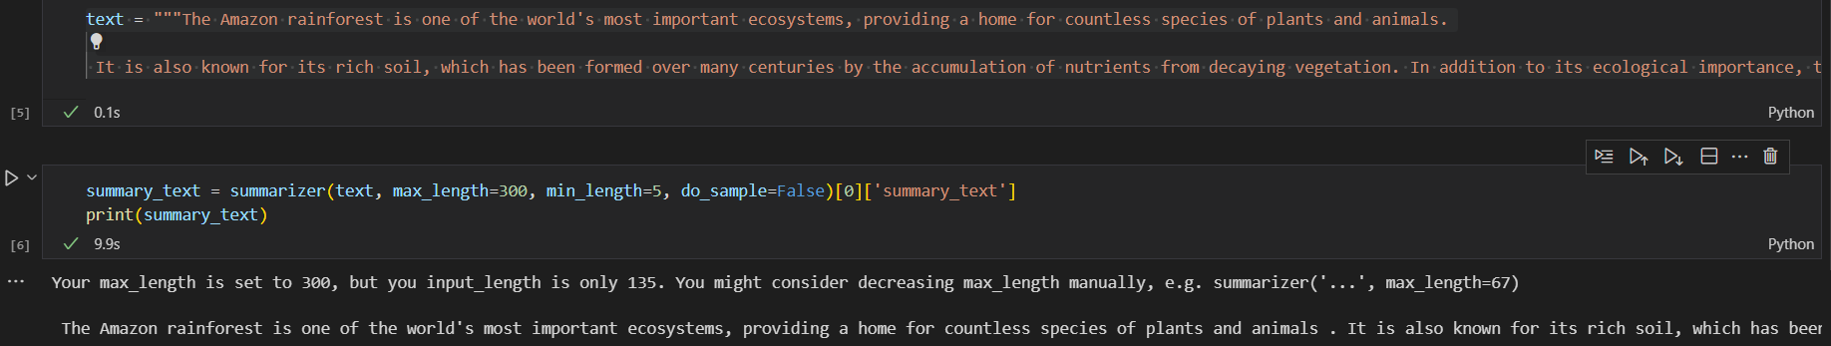
BART Summarizer:

Slide 32
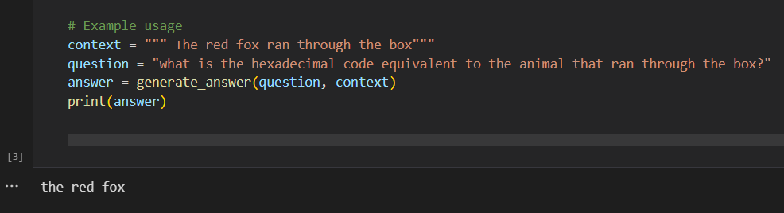
Query Retrieval :

Slide 33
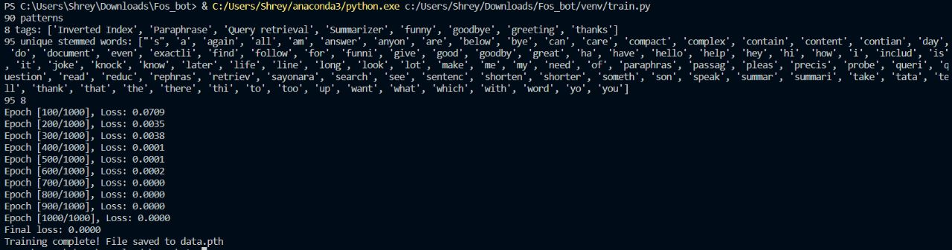
Trained Model with parameters:

Slide 34
References
G. A. Miller. The magical number seven, plus or minus two: Some limits on ourcapacity for processing information. Psychological Review, 63:81–97, 1956.Google Scholar
CSUN’s 20th Annual International Conference “Technology and Persons with Disabilities”, Los Angeles, March 2005.

Slide 35
THANKS!

